Slide 1
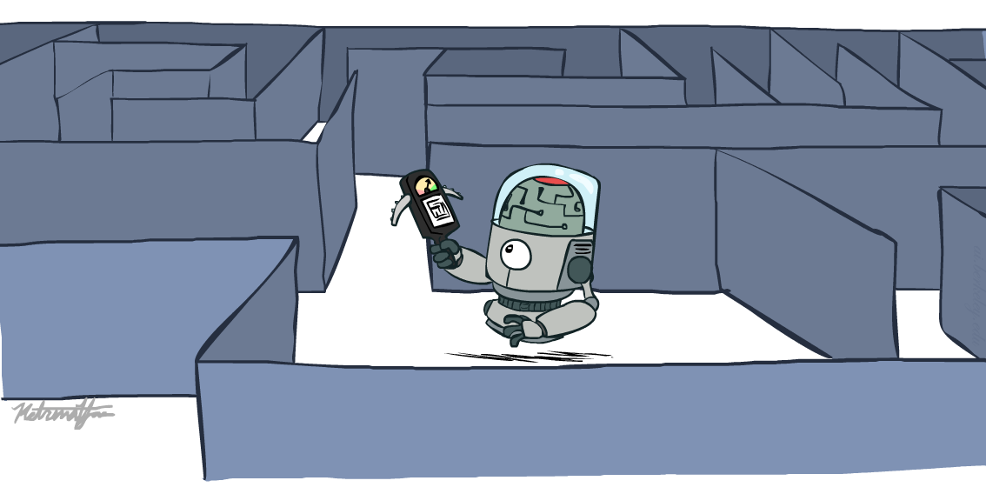
CS 4470: Artificial Intelligence
Informed Search
Instructor: Imtiaz Parvez
Utah Valley University
[These slides adapted from George Rudolph, Dan Klein and Pieter Abbeel at UC Berkley]
Notes:
Please retain proper attribution, including the reference to ai.berkeley.edu. Thanks!

Slide 2

Learning Outcomes
Solve Problems using Informed Searches
Heuristics
Greedy Search
A* Search
Model Problems as Graph Search

Slide 3
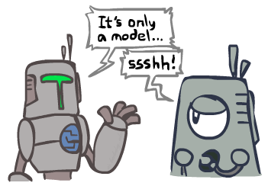
Search and Models
Search operates over models of the world
The agent doesn’t actually try all the plans out in the real world!
Planning is all “in simulation”
Your search is only as good as your models…

Slide 4

Informed Search

Slide 5



Search Heuristics
A heuristic is:
A function that estimates how close a state is to a goal
Designed for a particular search problem
Examples: Manhattan distance, Euclidean distance
10
5
11.2

Slide 6
Example: Heuristic Function
h(x)

Slide 7
Example: Heuristic Function
Heuristic: the number of the largest pancake that is still out of place
3
h(x)
4
3
4
3
0
4
4
3
4
4
2
3
Notes:
A* expanded 8100 ; Path cost = 33
UCS expanded 25263 . Path cost = 33
Greedy expanded 10 . Path cost = 41
[0, 7, 5, 3, 2, 1, 4, 6]
(7, 0, 5, 3, 2, 1, 4, 6)
(6, 4, 1, 2, 3, 5, 0, 7)
(3, 2, 1, 4, 6, 5, 0, 7)
(1, 2, 3, 4, 6, 5, 0, 7)
(5, 6, 4, 3, 2, 1, 0, 7)
(6, 5, 4, 3, 2, 1, 0, 7)
(0, 1, 2, 3, 4, 5, 6, 7)

Slide 8

Greedy Search

Slide 9
Example: Greedy Heuristic Function
h(x)

Slide 10
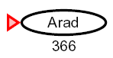

Greedy Search
Expand the node that seems closest…
What can go wrong?

Slide 11
Greedy Search
b
Strategy: expand a node that you think is closest to a goal state
Heuristic: estimate of distance to nearest goal for each state
A common case:
Best-first takes you straight to the (wrong) goal
Worst-case: like a badly-guided DFS
…
b
…

Slide 12

Video of Demo Contours Greedy (Empty)

Slide 13
Video of Demo Contours Greedy (Pacman Small Maze)

Slide 14
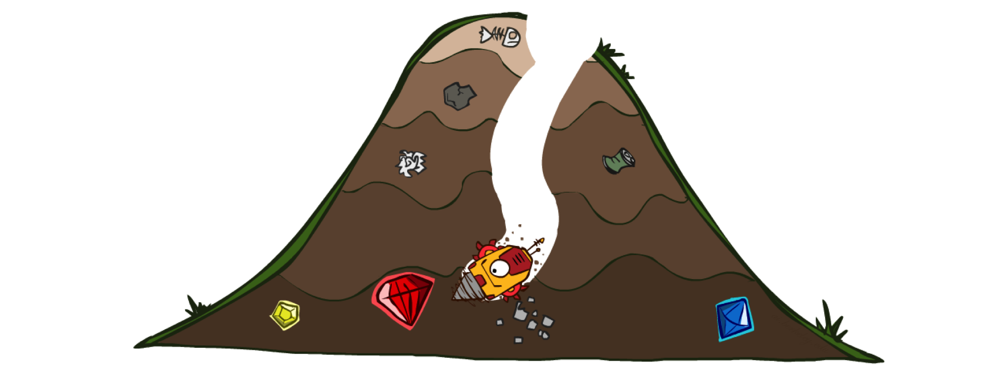
A* Search

Slide 15

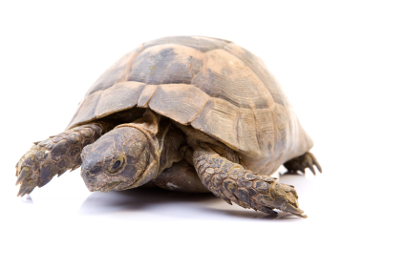

A* Search
UCS
Greedy
A*
Notes:
Notes: these images licensed from iStockphoto for UC Berkeley use. UVU: including under fair use.

Slide 16
Combining UCS and Greedy
Uniform-cost orders by path cost, or backward cost g(n)
Greedy orders by goal proximity, or forward cost h(n)
A* Search orders by the sum: f(n) = g(n) + h(n)
8
g = 0 h=6
S
e
h=1
g = 1 h=5
a
1
1
3
2
g = 2 h=6
g = 9 h=1
S
a
d
G
b
d
g = 4 h=2
e
h=6
1
h=5
h=2
h=0
1
g = 3 h=7
g = 6 h=0
g = 10 h=2
c
b
c
G
d
h=7
h=6
g = 12 h=0
G
Example: Teg Grenager

Slide 17
When should A* terminate?
Should we stop when we put a goal in the fringe?
No: only stop when we pull a goal off the fringe
h = 2
A
2
2
S
h = 3
h = 0
G
2
B
3
h = 1

Slide 18
Is A* Optimal?
h = 6
1
A
3
S
h = 7
G
h = 0
5
What is wrong?
Actual bad goal cost < estimated good goal cost
We need estimates to be less than actual costs!

Slide 19

Admissible Heuristics

Slide 20

Idea: Admissibility
Inadmissible (pessimistic) heuristics break optimality by trapping good plans on the fringe
Admissible (optimistic) heuristics slow down bad plans but never outweigh true costs

Slide 21


Admissible Heuristics
A heuristic h is admissible (optimistic) if:
where is the true cost to a nearest goal
Examples:
Defining admissible heuristics is the biggest effort in using A* in practice
4
15

Slide 22

Optimality of A* Tree Search

Slide 23


Optimality of A* Tree Search
Assume:
A is an optimal goal node
B is a suboptimal goal node
h is admissible
Claim:
A will exit the fringe before B
…

Slide 24


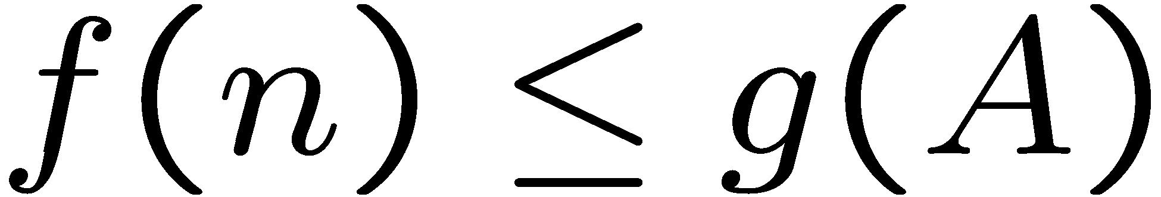
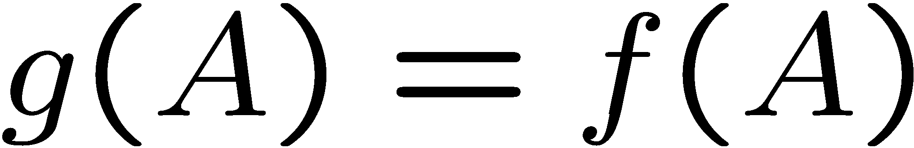
Optimality of A* Tree Search: Blocking
Proof:
Imagine B is on the fringe
Some ancestor n of A is on the fringe, too (maybe A!)
Claim: n will be expanded before B
f(n) is less or equal to f(A)
…
Definition of f-cost
Admissibility of h
h = 0 at a goal

Slide 25


Optimality of A* Tree Search: Blocking
Proof:
Imagine B is on the fringe
Some ancestor n of A is on the fringe, too (maybe A!)
Claim: n will be expanded before B
f(n) is less or equal to f(A)
f(A) is less than f(B)
…
B is suboptimal
h = 0 at a goal

Slide 26

Optimality of A* Tree Search: Blocking
Proof:
Imagine B is on the fringe
Some ancestor n of A is on the fringe, too (maybe A!)
Claim: n will be expanded before B
f(n) is less or equal to f(A)
f(A) is less than f(B)
n expands before B
All ancestors of A expand before B
A expands before B
A* search is optimal
…

Slide 27
Properties of A*

Slide 28
Properties of A*
Uniform-Cost
A*
b
b
…
…

Slide 29
UCS vs A* Contours
Uniform-cost expands equally in all “directions”
A* expands mainly toward the goal, but does hedge its bets to ensure optimality
Start
Goal
Start
Goal

Slide 30
Video of Demo Contours (Empty) -- UCS

Slide 31
Video of Demo Contours (Empty) -- Greedy

Slide 32
Video of Demo Contours (Empty) – A*

Slide 33
Video of Demo Contours (Pacman Small Maze) – A*

Slide 34



Comparison
Greedy
Uniform Cost
A*

Slide 35
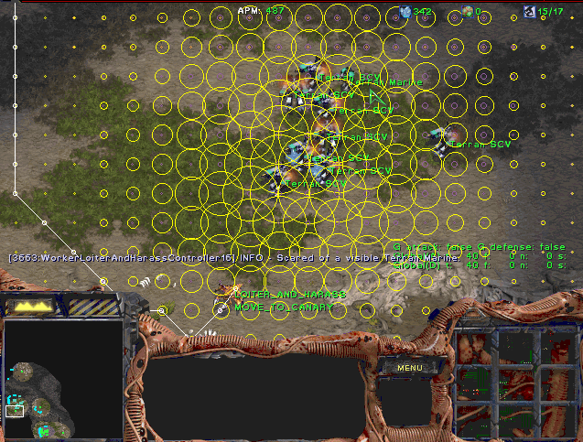
A* Applications

Slide 36
A* Applications
Video games
Path / routing problems
Resource planning problems
Robot motion planning
Language analysis
…

Slide 37
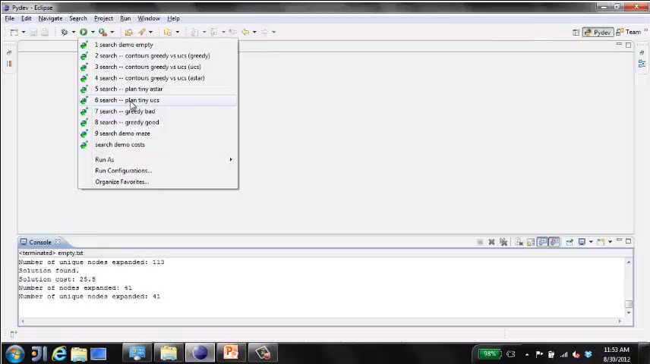
Video of Demo Pacman (Tiny Maze) – UCS / A*

Slide 38
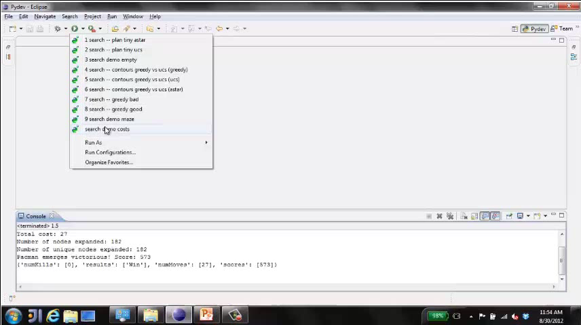
Video of Demo Empty Water Shallow/Deep – Guess Algorithm

Slide 39

Creating Heuristics

Slide 40
Creating Admissible Heuristics
Most of the work in solving hard search problems optimally is in coming up with admissible heuristics
Often, admissible heuristics are solutions to relaxed problems, where new actions are available
Inadmissible heuristics are often useful too
366
15

Slide 41
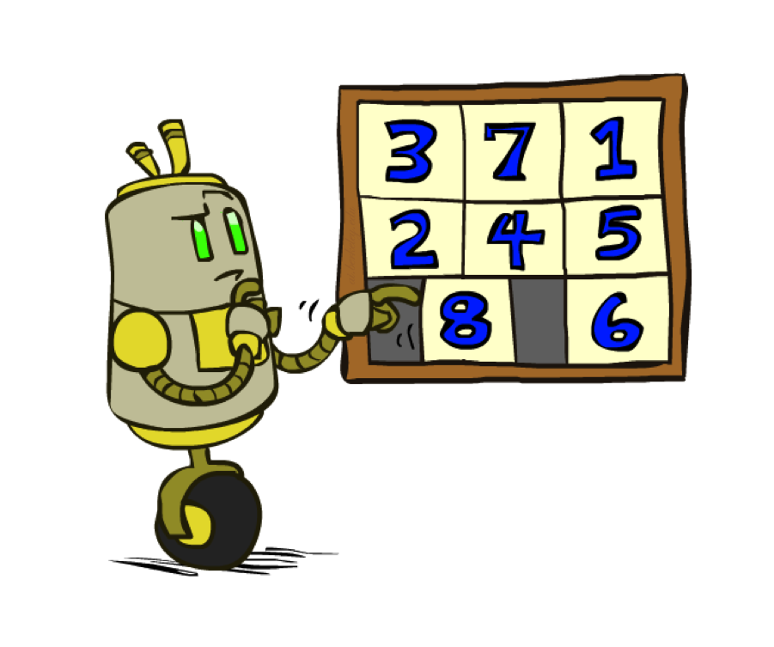
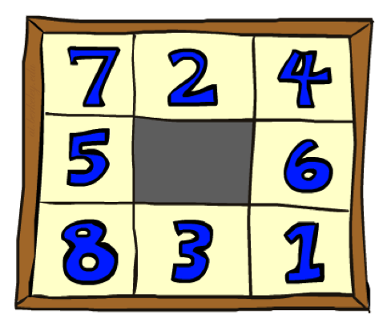
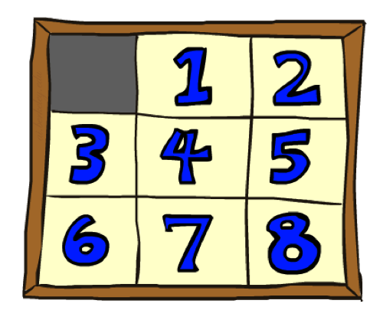
Example: 8 Puzzle
Start State
Actions
Goal State
What are the states?
How many states?
What are the actions?
How many successors from the start state?
What should the costs be?

Slide 42
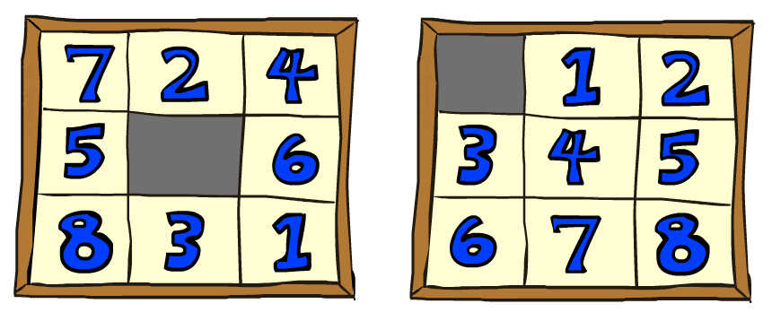
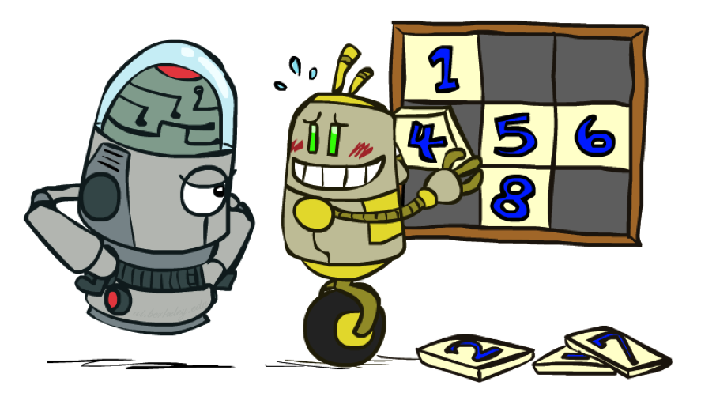
8 Puzzle I
Heuristic: Number of tiles misplaced
Why is it admissible?
h(start) =
This is a relaxed-problem heuristic
8
Start State
Goal State
 | Average nodes expanded when the optimal path has…
 | …4 steps | …8 steps | …12 steps
UCS | 112 | 6,300 | 3.6 x 10⁶
TILES | 13 | 39 | 227
Statistics from Andrew Moore

Slide 43
8 Puzzle II
What if we had an easier 8-puzzle where any tile could slide any direction at any time, ignoring other tiles?
Total Manhattan distance
Why is it admissible?
h(start) =
Start State
Goal State
 | Average nodes expanded when the optimal path has…
 | …4 steps | …8 steps | …12 steps
TILES | 13 | 39 | 227
MANHATTAN | 12 | 25 | 73
3 + 1 + 2 + … = 18

Slide 44
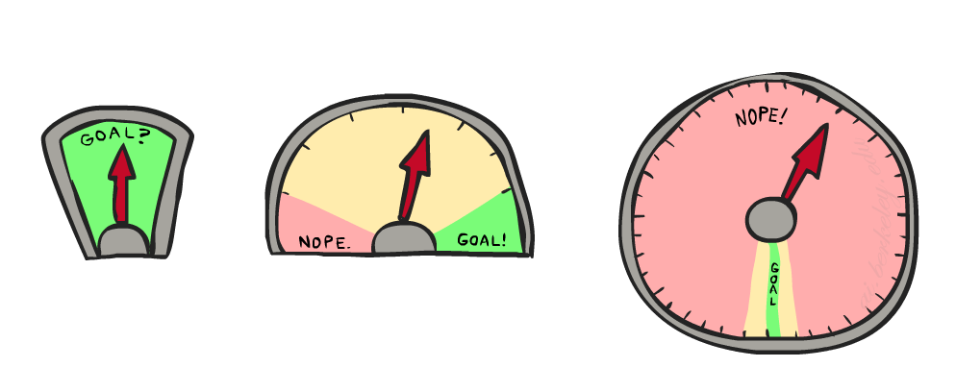
8 Puzzle III
How about using the actual cost as a heuristic?
Would it be admissible?
Would we save on nodes expanded?
What’s wrong with it?
With A*: a trade-off between quality of estimate and work per node
As heuristics get closer to the true cost, you will expand fewer nodes but usually do more work per node to compute the heuristic itself

Slide 45
Semi-Lattice of Heuristics

Slide 46

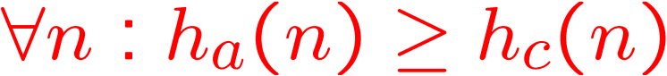
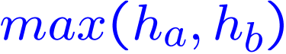

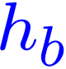
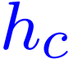

Trivial Heuristics, Dominance
Dominance: h_{a} ≥ h_{c} if
Heuristics form a semi-lattice:
Max of admissible heuristics is admissible
Trivial heuristics
Bottom of lattice is the zero heuristic (what does this give us?)
Top of lattice is the exact heuristic

Slide 47
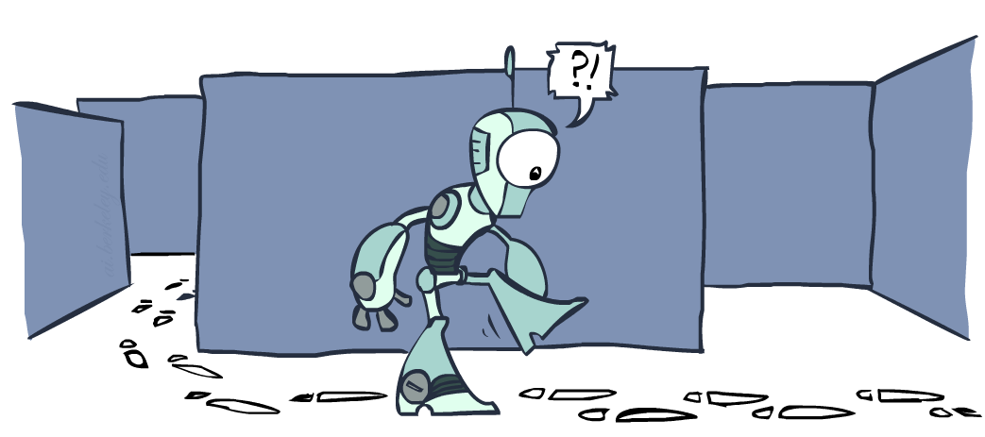
Graph Search

Slide 48
Tree Search: Extra Work!
Failure to detect repeated states can cause exponentially more work.
State Graph
Search Tree

Slide 49
BFS Graph Search Example
we shouldn’t bother expanding the circled nodes: WHY?
S
d
e
p
b
c
e
h
r
q
a
a
h
r
p
q
f
p
q
f
q
c
G
q
c
G
a
a

Slide 50
Graph Search
Idea: never expand a state twice
How to implement:
Tree search + set of expanded states (“closed set”)
Expand the search tree node-by-node, but…
Before expanding a node, check to make sure its state has never been expanded before
If not new, skip it, if new add to closed set
Important: store the closed set as a set, not a list
Can graph search wreck completeness? Why/why not?
How about optimality?

Slide 51
A* Graph Search Gone Wrong?
State space graph
Search tree
A
S (0+2)
1
S
1
C
h=4
h=1
A (1+4)
B (1+1)
h=2
1
2
B
3
C (2+1)
C (3+1)
h=1
G
G (5+0)
G (6+0)
h=0

Slide 52
Consistency of Heuristics
Main idea: estimated heuristic costs ≤ actual costs
Admissibility: heuristic cost ≤ actual cost to goal
h(A) ≤ actual cost from A to G
Consistency: heuristic “arc” cost ≤ actual cost for each arc
h(A) – h(C) ≤ cost(A to C)
Consequences of consistency:
The f value along a path never decreases
h(A) ≤ cost(A to C) + h(C)
A* graph search is optimal
A
1
C
h=4
h=1
h=2
3
G

Slide 53
Optimality
Tree search:
A* is optimal if heuristic is admissible
UCS is a special case (h = 0)
Graph search:
A* optimal if heuristic is consistent
UCS optimal (h = 0 is consistent)
Consistency implies admissibility
In general, most natural admissible heuristics tend to be consistent, especially if from relaxed problems

Slide 54

A*: Summary
A* uses both backward costs and (estimates of) forward costs
A* is optimal with admissible / consistent heuristics
Heuristic design is key: often use relaxed problems

Slide 55
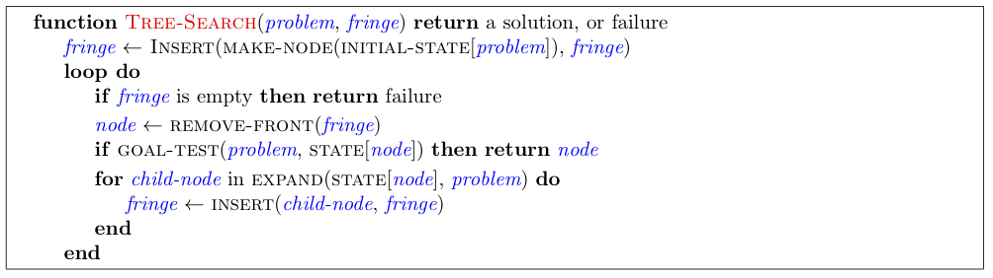
Tree Search Pseudo-Code

Slide 56
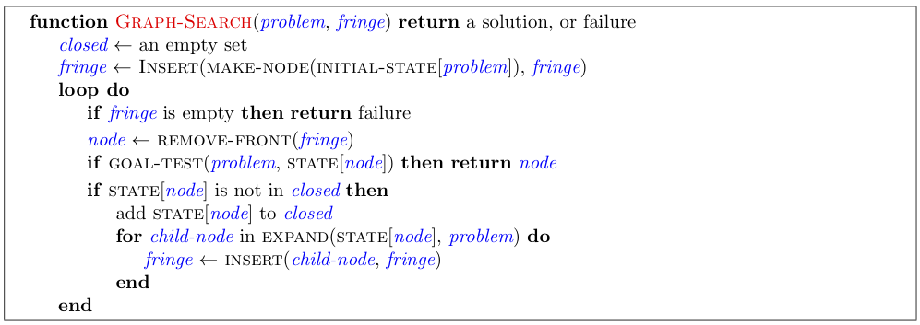
Graph Search Pseudo-Code

Slide 57
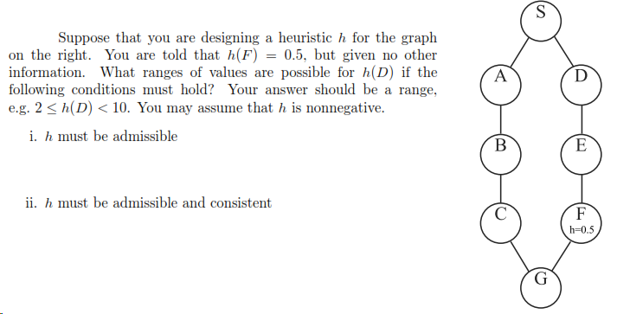
Search Problem Example 1

Slide 58
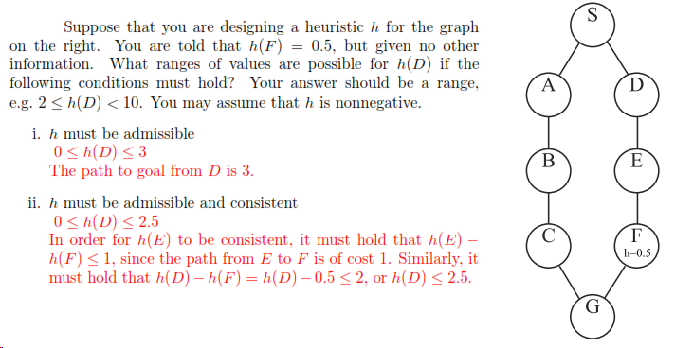
Search Problem Example 1 (solution)

